Slide 1
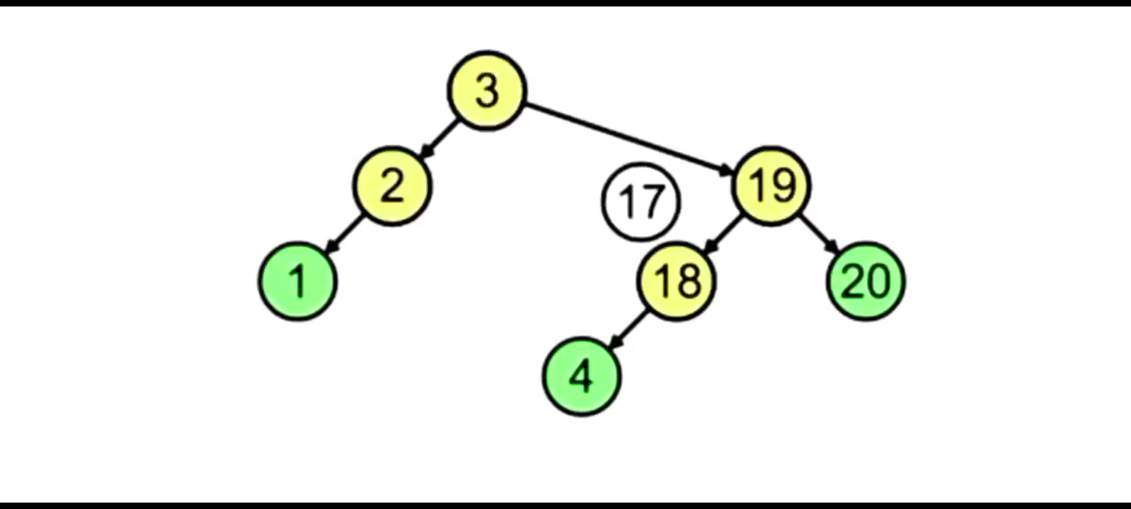
Search key element
In AVL Tree
Tayyba Zahid
SP22-BCS-078
Section-B
Guided by: Mam Yasmeen Jana

Slide 2
Agenda
Introduction
Algorithm Steps
Example
Code
Summary

Slide 3
Introduction
Searching in AVL Tree:
The search operation in an AVL tree is similar with the search operation in a normal Binary Search Tree. No rotation is required here since the tree doesn’t change as no node is inserted or deleted.

Slide 4
Steps of implementation
Start from the root node.
If the root node is NULL, return false.
Check if the current node’s value is equal to the value of the node to be searched. If yes, return true.
If the current node’s value is less than searched key then recur to the right subtree.
If the current node’s value is greater than searched key then recur to the left subtree.

Slide 5
Node being searched for : is found
val_to_find = 50
47
Compare 50 with 47
Found !
50>47
50
25
61
Compare 50 with 61
50<61
10
32
50
73
Compare 50 with 50
50=50
30
49
53

Slide 6
Node being searched for : is not found
val_to_find = 23
47
Compare 23 with 47
Not Found !
23<47
23
25
61
Compare 23 with 25
23<25
10
32
50
73
Compare 23 with 10
23!=10
30
49
53

Slide 7
Code
Search key element.cpp

Slide 8
Summary
Searching in AVL trees is the same as searching in a binary search tree.
Start the traversal of the tree from the root.
If the search value is equal to the current root, return true. Else, find
the value in the right and the left subtrees.

Slide 9

Thank you

